Slide 1


Michele Barbella
18/12/2024

Slide 2

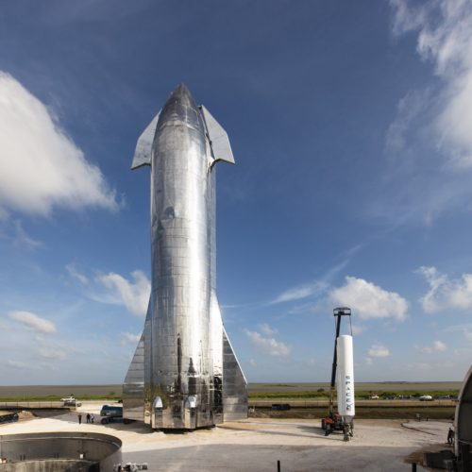
Outline
Executive Summary
Introduction
Methodology
Results
Conclusion
Appendix
This Photo by Unknown Author is licensed under CC BY-SA-NC

Slide 3
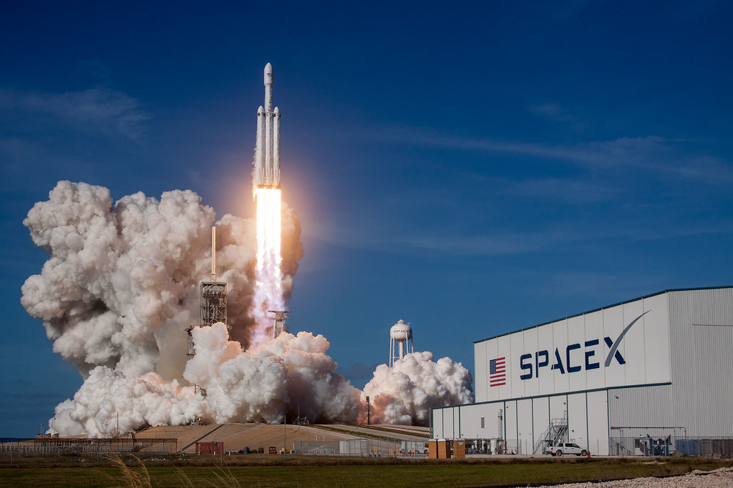
Executive Summary
SpaceY is a new commercial rocket launch provider who wants to bid against SpaceX.
• SpaceX advertises launch services starting at $62 million for stage rocket booster, so that it can be reused.
• SpaceX public statements missions that allow some fuel to be reserved for landing the 1st indicate a 1st stage Falcon 9 booster to cost upwards of $15 million to build without including R&D cost recoupment or profit margin.
• Given mission parameters such as payload mass and desired orbit, the models produced in this report were able to predict the first stage rocket booster landing successfully with an accuracy level of 83.3%.
• As a result, SpaceY will be able to make more informed bids against SpaceX by using 1st stage landing predictions as a proxy for the cost of a launch.
This Photo by Unknown Author is licensed under CC BY-NC

Slide 4

Introduction
This report has been prepared as part of the Applied Data Science Capstone course.
• In this capstone, I take the role of a data scientist working for a new rocket company called SpaceY.
• With the help of the data science findings and models in this report, SpaceY will be able to make more informed bids against SpaceX for a rocket launch.
This Photo by Unknown Author is licensed under CC BY-SA-NC

Slide 5

Section 1

Slide 6
Methodology
Executive Summary
The data science methodology employed for this report consists of the following steps:
1. Data Collection
2. Data Preparation and Wrangling
3. Exploratory Data Analysis (EDA)
4. Data Visualization
5. Model Development
6. Presenting Results to Stakeholders

Slide 7
Data Collection
API
• Acquired historical launch data from Open Source REST API for SpaceX
Requested and parsed the SpaceX launch data using the GET request
Filtered the dataframe to only include Falcon 9 launches
Replaced missing payload mass values from classified missions with mean
Web Scraping
• Acquired historical launch data from Wikipedia page 'List of Falcon 9 and Falcon Heavy Launches'
• Requested the Falcon9 Launch Wiki page from its Wikipedia URL
• Extracted all column/variable names from the HTML table header
• Parsed the table and converted it into a Pandas data frame

Slide 8
Data Collection – SpaceX API
Acquired historical launch data from Open Source REST API for SpaceX
Requested and parsed the SpaceX launch data using the GET request
Filtered the dataframe to only include Falcon 9 launches
Replaced missing payload mass values from classified missions with mean
https://github.com/michelebarbella/Applied-Data-Science-Capstone/blob/main/jupyter-labs-spacex-data-collection-api.ipynb

Slide 9
Data Collection - Scraping
Acquired historical launch data from Wikipedia page 'List of Falcon 9 and Falcon Heavy Launches'
• Requested the Falcon9 Launch Wiki page from its Wikipedia URL
• Extracted all column/variable names from the HTML table header
• Parsed the table and converted it into a Pandas data frame
https://github.com/michelebarbella/Applied-Data-Science-Capstone/blob/main/jupyter-labs-webscraping.ipynb

Slide 10

Data Wrangling
Explored data to determine the label for training supervised models
Calculated the number of launches on each site
Calculated the number and occurrence of each orbit
Calculated the number and occurrence of mission outcome per orbit type
Created a landing outcome training label from 'Outcome' column
Training label: 'Class’
Class = 0; first stage booster did not land successfully
None None; not attempted
None ASDS; unable to be attempted due to launch failure
False ASDS; drone ship landing failed
False Ocean; ocean landing failed
False RTLS; ground pad landing failed
Class = 1; first stage booster landed successfully
True ASDS; drone ship landing succeeded
True RTLS; ground pad landing succeeded
True Ocean; ocean landing succeeded
https://github.com/michelebarbella/Applied-Data-Science-Capstone/blob/main/labs-jupyter-spacex-Data%20wrangling.ipynb

Slide 11
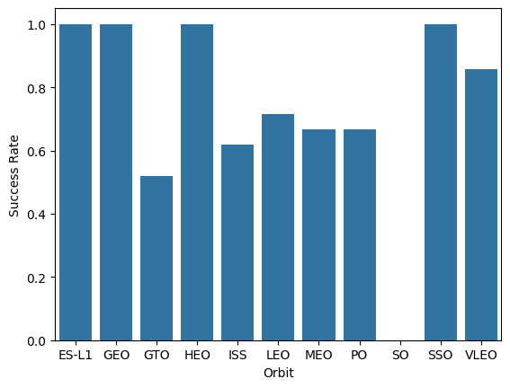
EDA with Data Visualization
EDA with visualization
Read the dataset into a Pandas dataframe
Used Matplotlib and Seaborn visualization libraries to plot
• FlightNumber x PayloadMass
• FlightNumber x LaunchSite
• Payload x LaunchSite
• Orbit type x Success rate
• FlightNumber x Orbit type
• Payload x Orbit type
• Year x Success rate
https://github.com/michelebarbella/Applied-Data-Science-Capstone/blob/main/edadataviz.ipynb

Slide 12
EDA with SQL
EDA with SQL
Loaded data into an IBM DB2 instance
Ran SQL queries to display and list information about
• Launch sites
• Payload masses
• Booster versions
• Mission outcomes
• Booster landings
https://github.com/michelebarbella/Applied-Data-Science-Capstone/blob/main/jupyter-labs-eda-sql-coursera_sqllite.ipynb

Slide 13

Build an Interactive Map with Folium
Launch Sites Location Analysis
• Used Python interactive mapping library called Folium
• Marked all launch sites on a map
• Marked the successful/failed launches for each site on map
• Railways
• Highways
• Coastlines
• Calculated the distances between a launch site to its proximities
• Cities
https://github.com/michelebarbella/Applied-Data-Science-Capstone/blob/main/lab_jupyter_launch_site_location.ipynb

Slide 14
Build a Dashboard with Plotly Dash
Launch Records Dashboard
• Used Python interactive dashboarding library called Plotly Dash to enable stakeholders to explore and manipulate data in an interactive and real-time way
• Pie chart showing success rate
Color coded by launch site
• Scatter chart showing payload mass vs. landing outcome
• Color coded by booster version
• With range slider for limiting payload amount
• Drop-down menu to choose between all sites and individual launch sites
https://github.com/michelebarbella/Applied-Data-Science-Capstone/blob/main/spacex_dash_app.py

Slide 15
Predictive Analysis (Classification)
Imported libraries and defined function to create confusion matrix
• Pandas, Numpy, Matplotlib, Seaborn, Sklearn
Loaded the dataframecreated during data collection
Created a column for our training label 'Class' created during data wrangling
Standardized the data
Split the data into training data and test data
Fit the training data to various model types
• Logistic Regression, Support Vector Machine, Decision Tree Classifier, K Nearest Neighbors Classifier,
Used a cross-validated grid-search over a variety of hyperparameters to select the best ones for each model
• Enabled by Scikit-learn library function GridSearchCV
Evaluated accuracy of each model using test data to select the best model
https://github.com/michelebarbella/Applied-Data-Science-Capstone/blob/main/SpaceX_Machine%20Learning%20Prediction_Part_5.ipynb

Slide 16
Results
Exploratory data analysis results
Interactive analytics demo in screenshots
Predictive analysis results

Slide 17

Section 2

Slide 18
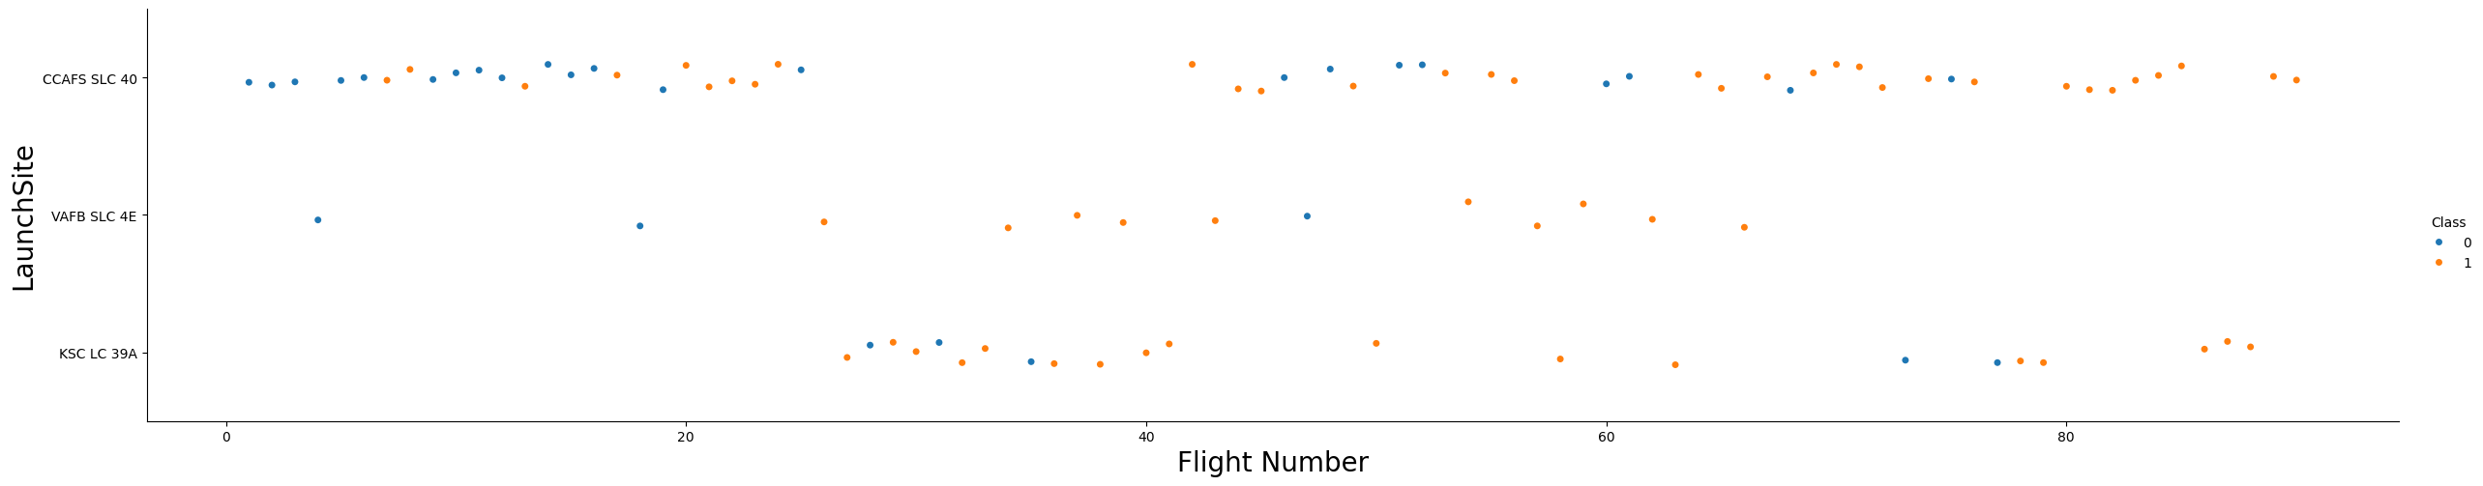
Flight Number vs. Launch Site
Show a scatter plot of Flight Number vs. Launch Site
CCAFS SLC 40 appears to have been where most of the early 1st stage landing failures took place

Slide 19
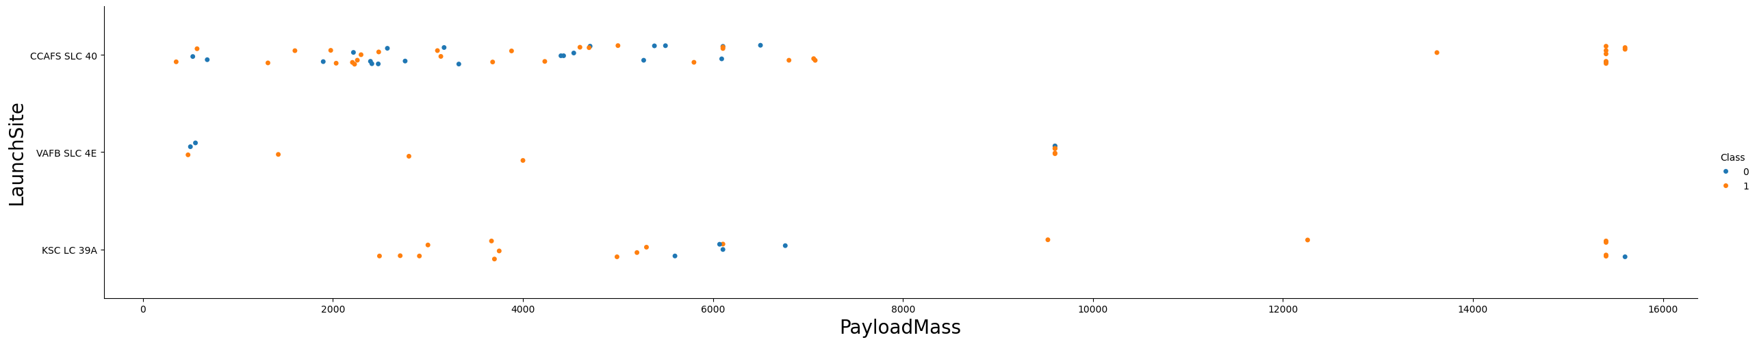
Payload vs. Launch Site
Show a scatter plot of Payload vs. Launch Site
CCAFS SLC 40 and KSC LC 39A appear to be favored for heavier payloads

Slide 20

Success Rate vs. Orbit Type
Show a bar chart for the success rate of each orbit type
All orbit types except 'SO' have had successful 1st stage landings

Slide 21
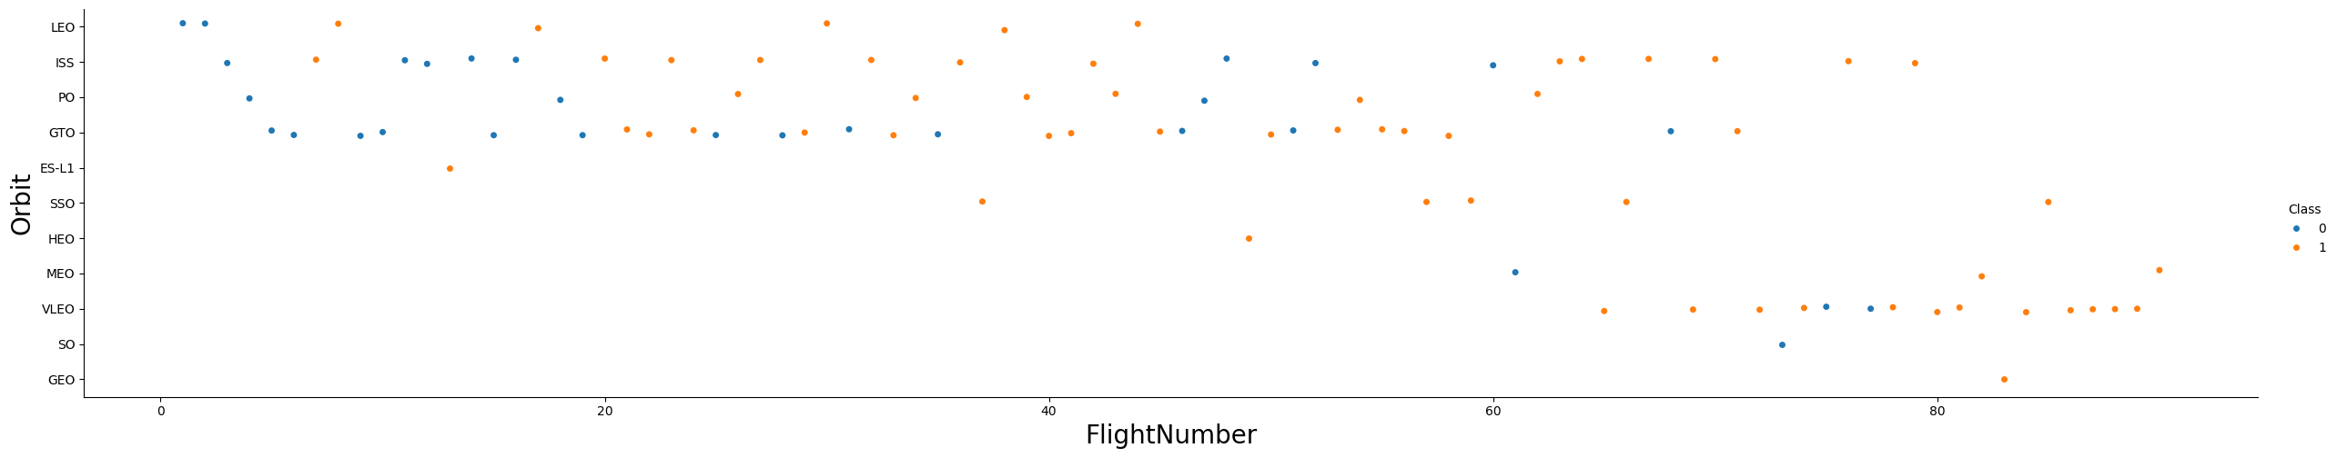
Flight Number vs. Orbit Type
Show a scatter point of Flight number vs. Orbit type
Flight number positively correlated with 1st stage recovery for all orbit types

Slide 22
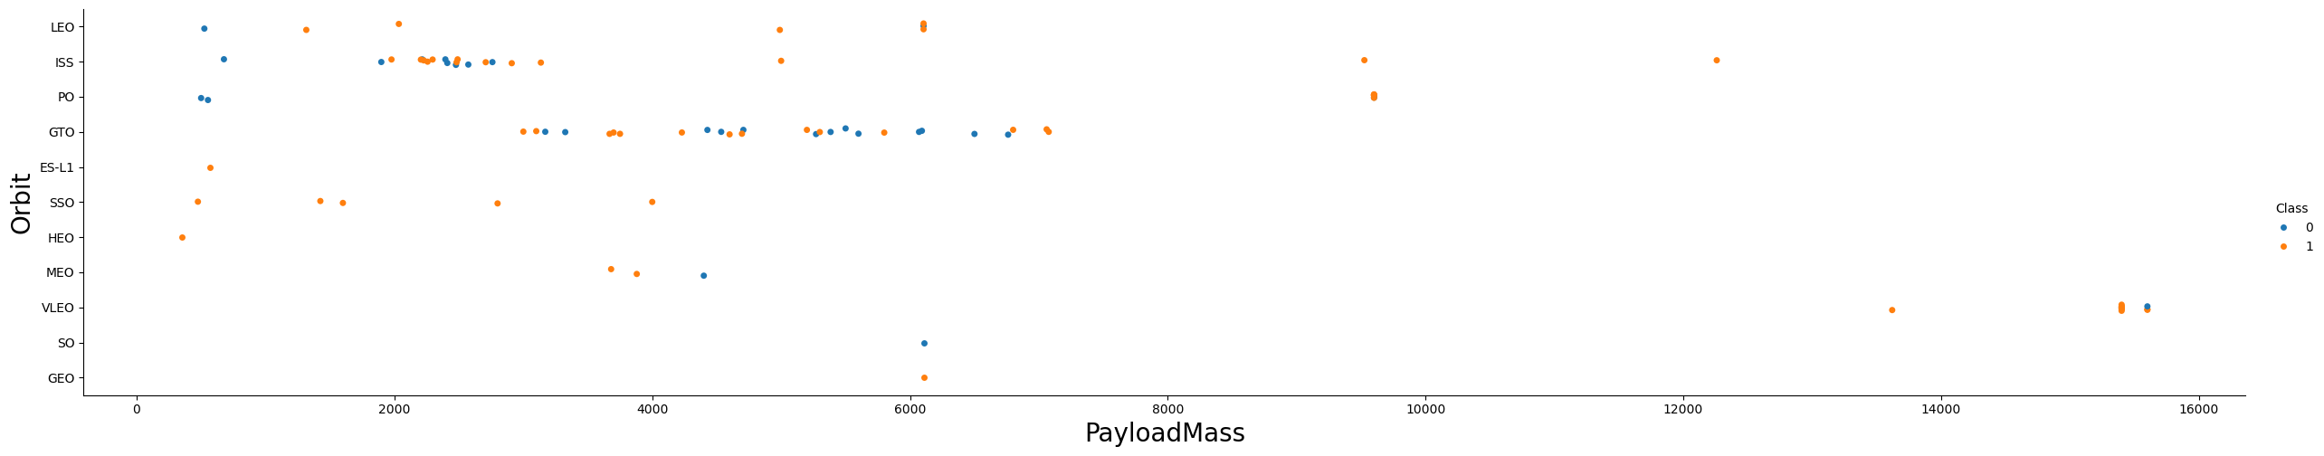
Payload vs. Orbit Type
Show a scatter point of payload vs. orbit type
Heavier payloads have a negative influence on GTO orbits and positive influence on ISS orbits

Slide 23
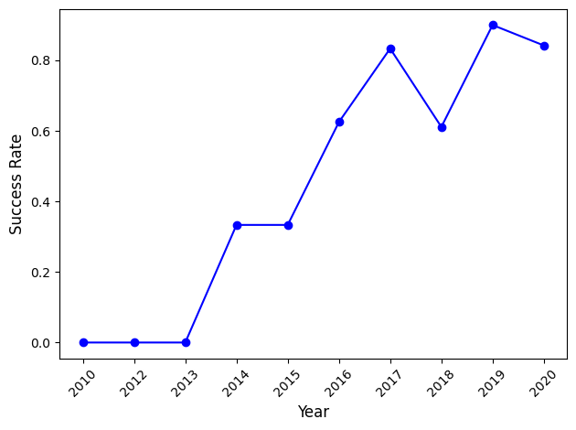
Launch Success Yearly Trend
Show a line chart of yearly average success rate
success rate trending positively on a yearly basis since 2013

Slide 24
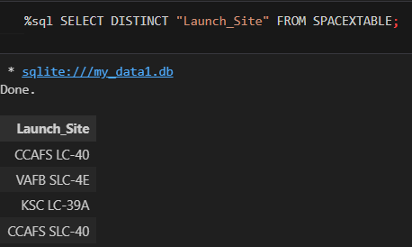
All Launch Site Names
Find the names of the unique launch sites

Slide 25
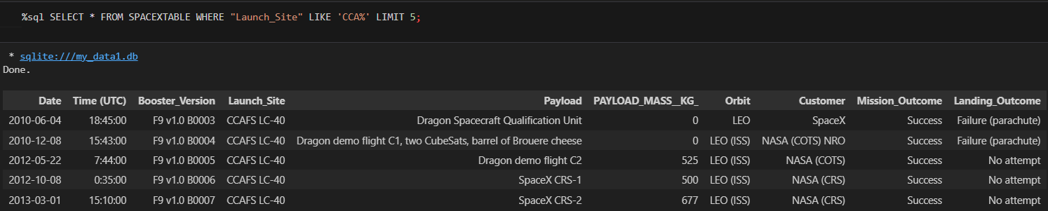
Launch Site Names Begin with 'CCA'
Find 5 records where launch sites begin with `CCA`
All 5 launches resulted in a successful Mission Outcome

Slide 26
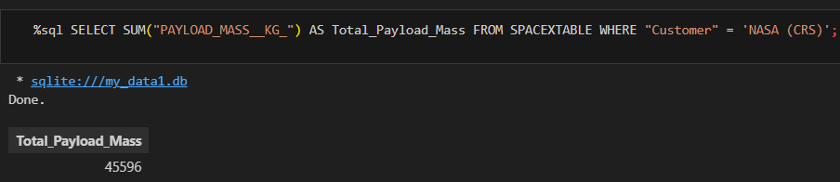
Total Payload Mass
Calculate the total payload carried by boosters from NASA
45,596 KG, total

Slide 27
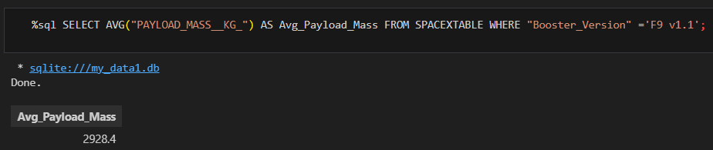
Average Payload Mass by F9 v1.1
Calculate the average payload mass carried by booster version F9 v1.1
2928,4 Kg

Slide 28
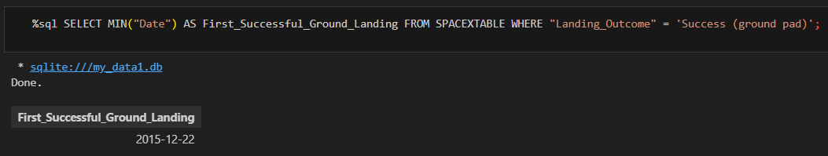
First Successful Ground Landing Date
Find the dates of the first successful landing outcome on ground pad
2015 12 22, more than 5 years after the first Falcon 9 launch on 2010 06 04

Slide 29
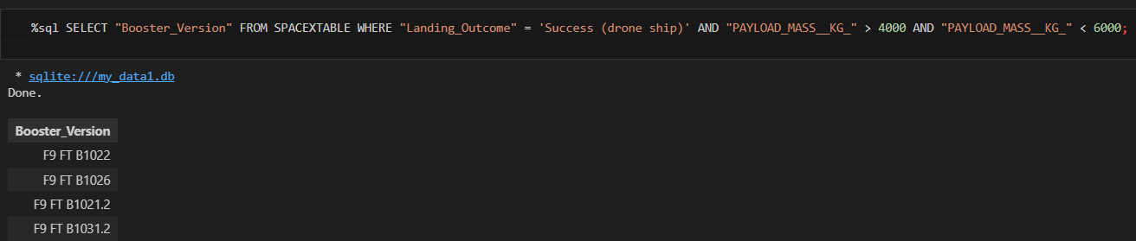
Successful Drone Ship Landing with Payload between 4000 and 6000
List the names of boosters which have successfully landed on drone ship and had payload mass greater than 4000 but less than 6000

Slide 30
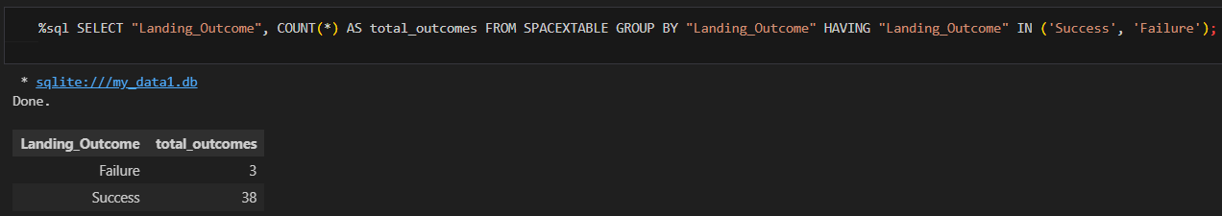
Total Number of Successful and Failure Mission Outcomes
Calculate the total number of successful and failure mission outcomes

Slide 31
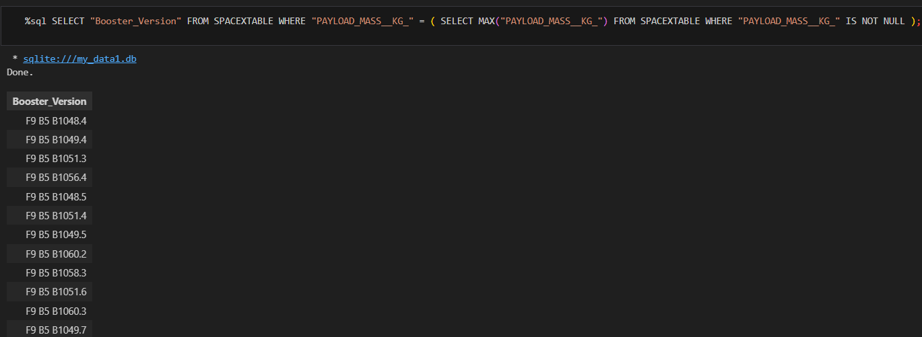
Boosters Carried Maximum Payload
List the names of the booster which have carried the maximum payload mass

Slide 32
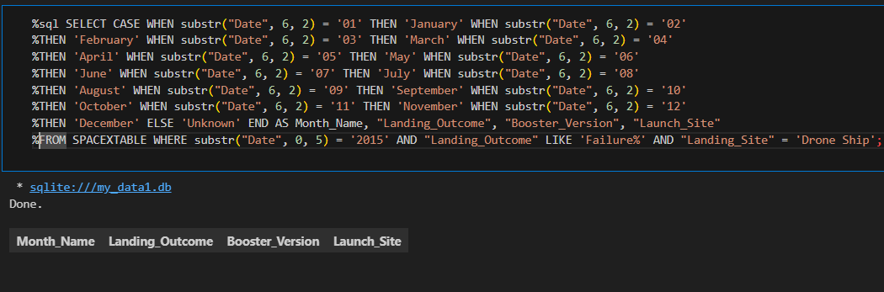
2015 Launch Records
List the failed landing_outcomes in drone ship, their booster versions, and launch site names for in year 2015
Resulting query haven’t results

Slide 33
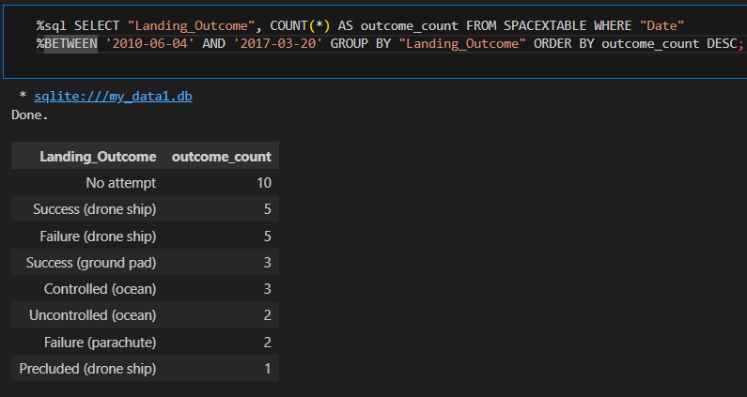
Rank Landing Outcomes Between 2010-06-04 and 2017-03-20
Rank the count of landing outcomes (such as Failure (drone ship) or Success (ground pad)) between the date 2010-06-04 and 2017-03-20, in descending order

Slide 34

Section 3

Slide 35
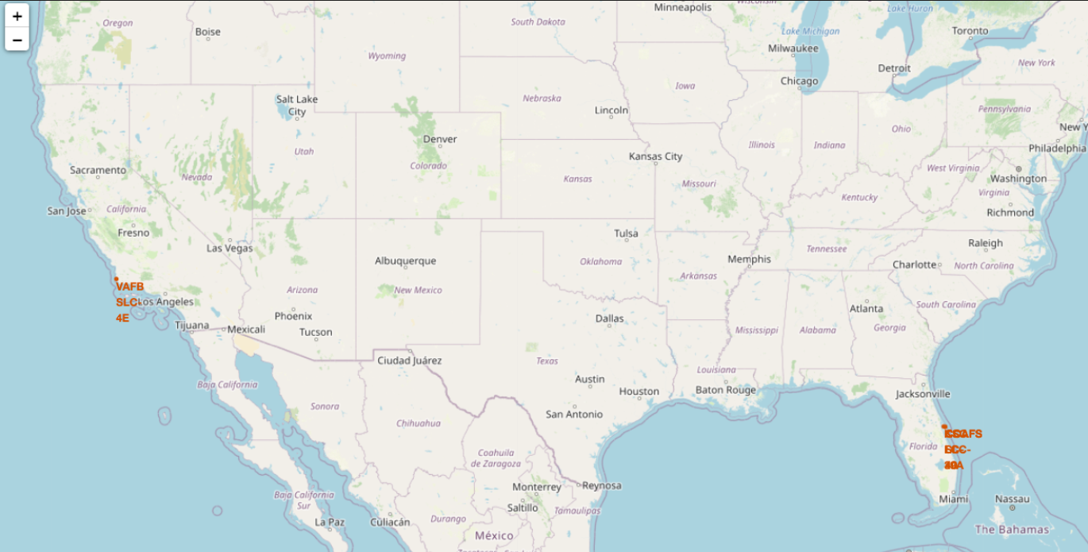
Launch Sites Proximities Analysis
Visualizing the launch sites on a map highlights the importance of launch site proximity to the coast and equator
https://github.com/michelebarbella/Applied-Data-Science-Capstone/blob/main/lab_jupyter_launch_site_location.ipynb

Slide 36
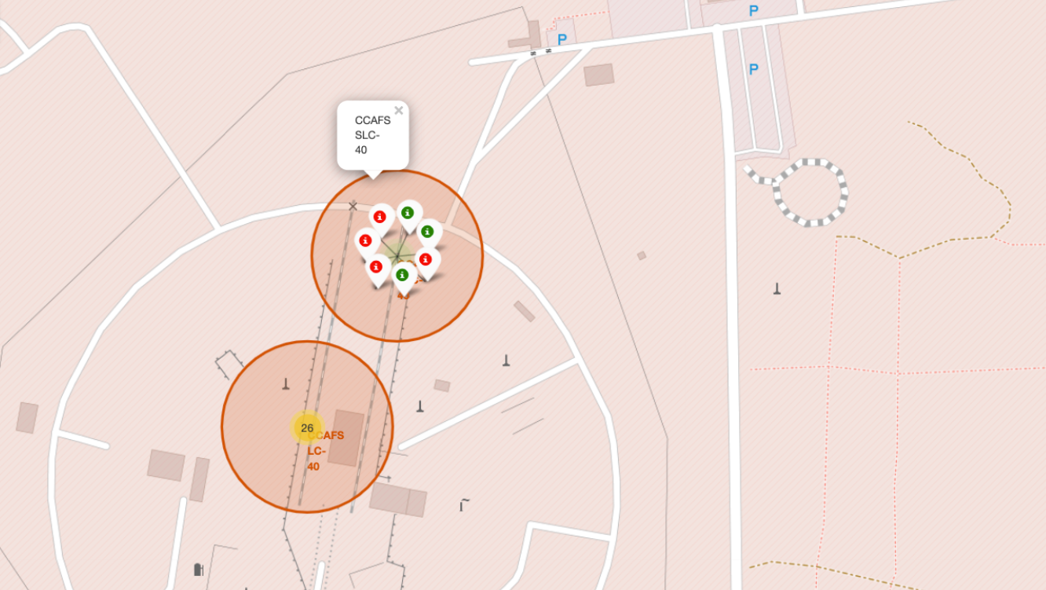
Launch Sites Proximities Analysis
Visualizing the booster landing outcomes for each launch site highlights which launch sites have relatively high success rates, namely CCAFS SLC-40
https://github.com/michelebarbella/Applied-Data-Science-Capstone/blob/main/lab_jupyter_launch_site_location.ipynb

Slide 37
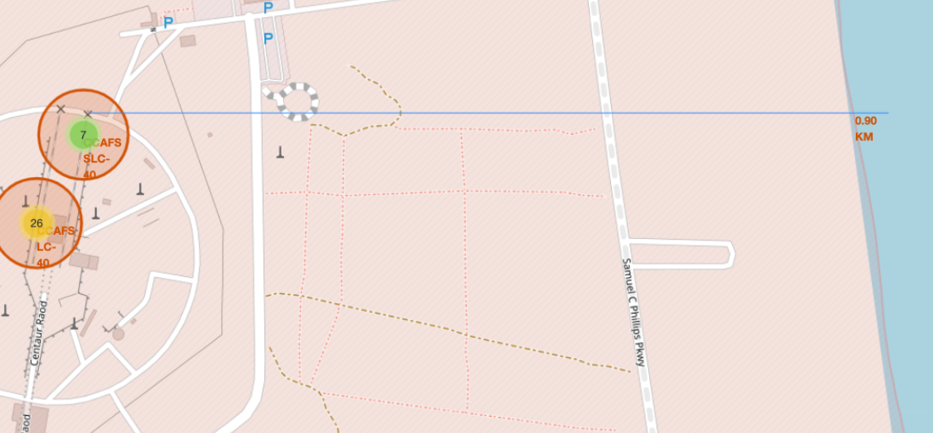
Launch Sites Proximities Analysis
Coastline is far about 900 meters and there are 3 parking in the proximities
https://github.com/michelebarbella/Applied-Data-Science-Capstone/blob/main/lab_jupyter_launch_site_location.ipynb

Slide 38

Section 4

Slide 39
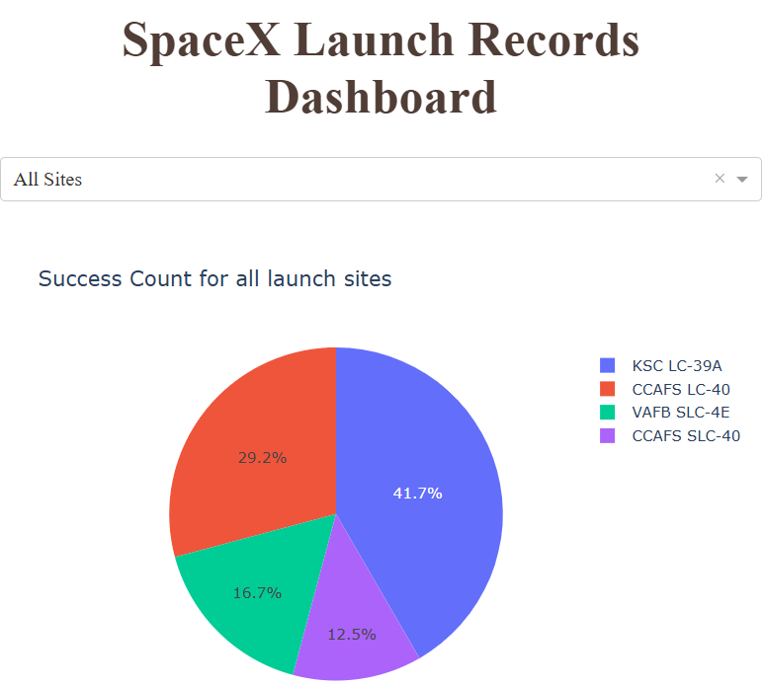
Success count for all launch sites
KSC LC-39 A has the highest booster landing success rate, while CCAFS SLC-40 the worst

Slide 40
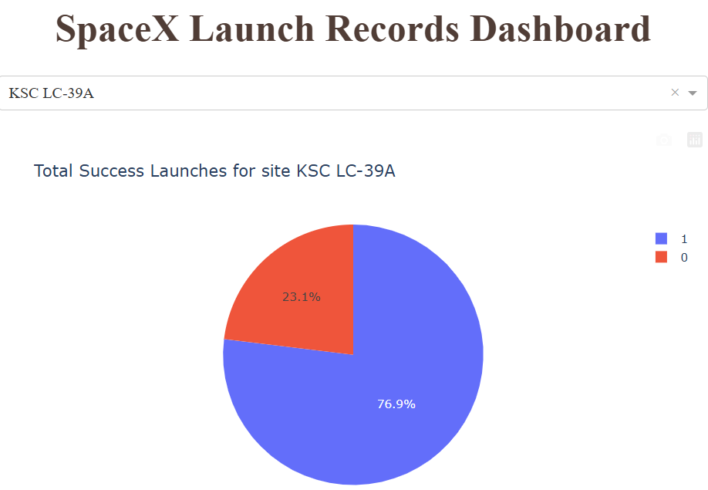
Total success launches for site KSC LC-39A
Booster landing success rate for KSC LC-39A

Slide 41
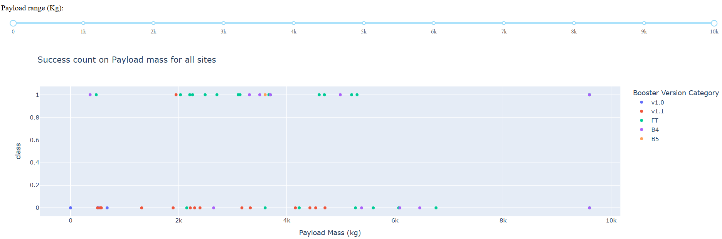
Success count on Payload mass
Payloads < 5,300 kg had the highest booster landing success rate
Payloads > 5,300 kg had the lowest booster landing success rate

Slide 42

Section 5

Slide 43
Classification Accuracy
Visualize the built model accuracy for all built classification models, in a bar chart
Tree CV has the highest classification accuracy

Slide 44
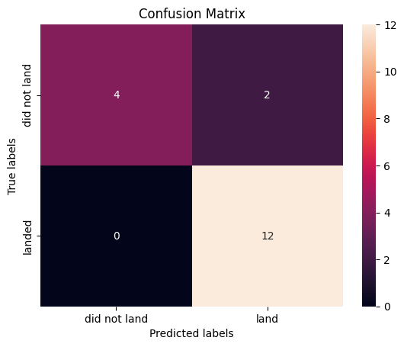
Confusion Matrix
Show the confusion matrix of the best performing model with an explanation
Examining the confusion matrix, we see that Tree CV can distinguish between the different classes. We see that the problem is false positives.
True Postive - 12 (True label is landed, Predicted label is also landed)
False Postive - 4 (True label is not landed, Predicted label is landed)

Slide 45
Conclusions
Using the models from this report SpaceY can predict when SpaceX will successfully land the 1st stage booster with 90% accuracy
SpaceX public statements indicate the 1st stage booster costs upwards of $15 million to build
This will enable SpaceY to make more informed bids against SpaceX, since they will have a good idea when to expect the SpaceX bid to include the cost of a sacrificed 1st stage booster
With a list price of $62 million per launch, sacrificing the $15+ million 1st stage, would put the SpaceX bid at upwards of $77 million
Biggest opportunities going forward to make even more informed bids:
Freeze the best performing combination of model and hyperparameters and re-fit using the whole dataset instead of just the training data
• Potentially better than using only part of the data to fit the model, but you would no longer be able to measure the accuracy of the resulting model
Incorporate additional launch data to the dataset and model as it becomes available
Subdivide the current model into two models
Predict if SpaceX will ATTEMPT to land the 1st stage
Predict if SpaceX will SUCCEED in their attempt
Create a related model that predicts if SpaceX will launch using a previously-flown 1st stage booster
Would enable SpaceY to take into account when the SpaceX bid would likely include a discount

Slide 46
Conclusions
Using the models developed in this report, SpaceY can predict SpaceX's likelihood of successfully landing the first-stage booster with an accuracy of 83.3%. This insight is critical, given that SpaceX has publicly stated that the cost of building a first-stage booster exceeds $15 million.
By leveraging these predictions, SpaceY can make more informed bids against SpaceX, particularly when anticipating whether SpaceX's bid includes the cost of a sacrificed first-stage booster. With a launch list price of $62 million, factoring in a sacrificed $15+ million booster would drive SpaceX’s bid to approximately $77 million or higher.
Key opportunities to enhance SpaceY’s bidding strategy further include:
1. Refining the Model: Freeze the best-performing model and hyperparameter combination, then re-train it using the entire dataset instead of just the training portion. While this approach could improve predictive power, it would eliminate the ability to measure accuracy on unseen data.
2. Incorporating New Data: Continuously update the model with additional launch data as it becomes available, ensuring predictions remain relevant and accurate.
3. Developing Submodels: Create two specialized models:
- One to predict whether SpaceX will attempt to land the first-stage booster.
- Another to predict the likelihood of success if SpaceX attempts the landing.
4. Introducing a Booster Reuse Model: Build a related model to predict whether SpaceX will use a previously flown booster for a given launch. This would help SpaceY anticipate scenarios where SpaceX might include a discount in its bid due to reusability.
By adopting these strategies, SpaceY can gain a competitive edge and develop more precise bidding frameworks against SpaceX.

Slide 47
Appendix
Notebooks to recreate dataset, analysis, and models:
https://github.com/michelebarbella/Applied-Data-Science-Capstone/tree/main
References
• https://aviationweek.com/defense-space/space/podcast-interview-spacexs-elon-musk
• https://datascience.stackexchange.com/a/33050
• https://www.spacex.com/vehicles/falcon-9/

Slide 48


